Slide 1
Hospital Patient Data Analysis & Treatment Insights System
Group Name:- Analytica
Member:-
Sylvester Gard
Nidhi Dhamnaskar
Srujan Gaikwad
Rohan Bhalerao

Slide 2
Title of the Project:-
Hospital Patient Data Analysis & Treatment Insights System
Name of the Group:-
Analytica
Technology used:-
Python
Power BI
CSV Dataset

Slide 3
Introduction
Problem Statement:-
Hospitals generate large volumes of patient data daily. However, this data is often:-
Unstructured
Difficult to Analyze
Not used effectively for decision-making
As a result, hospitals face challenges in:-
Understanding patient trends
Monitoring treatment costs
Analyzing disease patterns
Optimizing hospital resources

Slide 4
Introduction
Project Description
This project is a data analytics solutions that analyzes hospital patient data to generate meaningful insights.
The System
Cleans raw healthcare data using Python
Analyzes patient demographics, diseases, and costs
Presents insights through an interactive Power BI dashboard
The dashboard helps users understand hospital performance at a glance

Slide 5
Project Objectives
Analyze patient demographics (age,gender)
Study disease-wise patient distribution
Monitor hospital admission trends over time
Calculate average treatment cost and stay duration
Provide interactive filtering for better decision-making
Convert raw data into visual insights

Slide 6
Dataset Used:-
Healthcare patient dataset (CSV format)
Cleaned using Python
Contains information such as:-
Patient ID
Age
Gender
Disease
Admission Date
Discharge Date
Treatment Cost
Length Cost
Data Preparation
Missing values handles
Duplicate records removed
Date formats standardized
Final Cleaned Dataset used for Power BI

Slide 7
Technologies:-
Python
Pandas
NumPy
Seaborn
Matplotlib
Used for Data Cleaning and Processing:-
Power BI Desktop
KPI Cards
Bar Charts
Donut Charts
Line Charts
Slicers & Filters
CSV
Dataset storage and transfer

Slide 8
Project Flow
Raw healthcare data collected (CSV)
Data cleaned and processed using Python
Cleaned dataset loaded into Power BI
Insights generated for decision-making
Interactive dashboard designed
Relationships and measures created

Slide 9
Hospital Patient Analytics Dashboard:-
The dashboard includes:
  KPI Cards for quick insights
  Interactive charts for detailed analysis
  Filters and slicers for user-driven exploration
This dashboard is designed to be:
  Simple
  Professional
  Highly interactive

Slide 10
KPIs Displayed:-
Total Patients
Average Length of Stay (Days)
Average Treatment Costs
Average Patient Age
Purpose:-
These KPIs provide a high-level summary of hospital performance
Visuals Included:-
Disease-wise Patient Distribution (Bar Chart)
Gender Distribution (Donut Chart)
Admission Trend Over Time (Line Chart)
Benefits:-
Easy comparison
Clear trend identification
Better understanding of patient patterns

Slide 11
Interactive Elements:-
Disease Slicer
Gender Slicer
Admission date range filter
Discharge date range filter
Age range slider
Length of stay filter
Impact:-
Users can dynamically explore data based on their requirements
Problems Solved:-
Converts raw healthcare data into insights
Helps hospitals identify high-demand diseases
Assists in monitoring treatment costs
Improves decision-making using visuals
Saves time compared to manual analysis

Slide 12
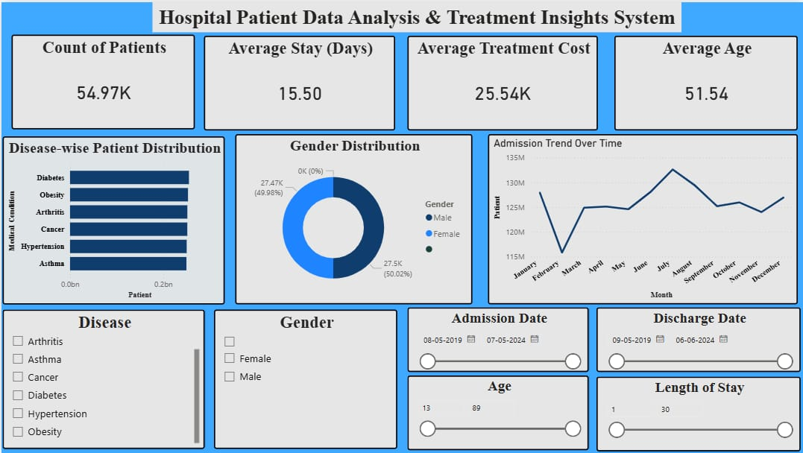
Screenshot
Overview

Slide 13
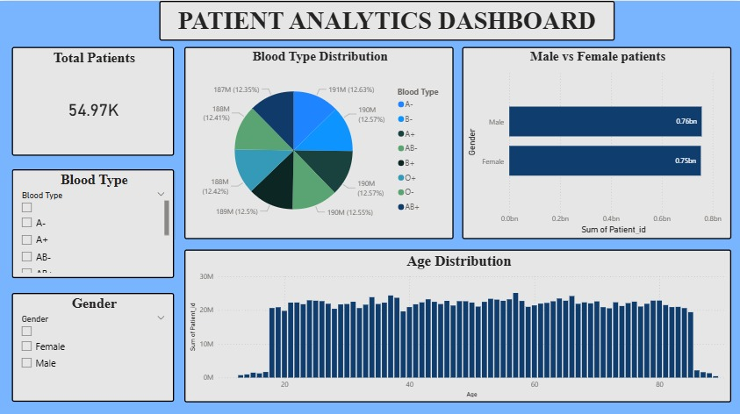
Screenshot
2. Patient Analytics Dashboard

Slide 14
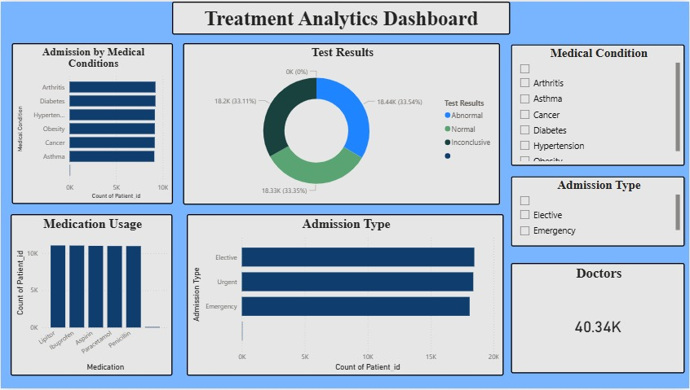
Screenshot
3. Treatment Analytics Dashboard

Slide 15
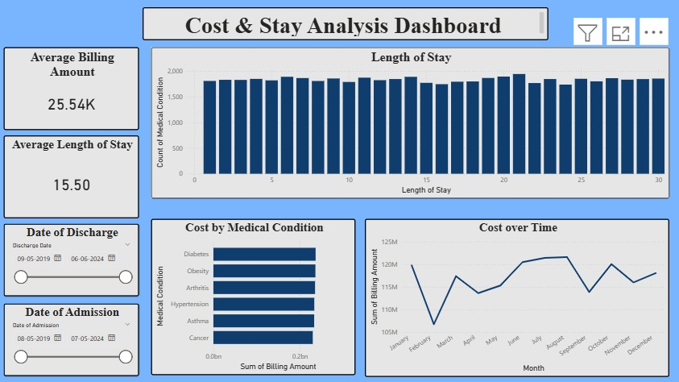
Screenshot
4. Cost and Stay Analytics Dashboard

Slide 16
Advantages:-
Easy to understand dashboard
Interactive and user-friendly
Reduces manual reporting effort
Supports data-driven decisions
Scalable for larger datasets
Future Enhancements:-
Real-time data integration
Predictive analytics using Machine Learning
Role-based dashboards (Doctor/Admin)
Integration with live hospital systems
Deployment on Power BI Service

Slide 17
Conclusion:-
The Hospital Patient Data Analysis & Treatment Insights System successfully demonstrates how data analytics and visualization can improve healthcare decision-making.
The project effectively:-
Analyzes patient data
Generates actionable insights
Uses professional Power BI features
Drive link for the project:-
https://drive.google.com/drive/folders/1Pz96TFs1zCCpXmzFt_ZvdIObsh9K3tP0?usp=drive_link
GitHub Link:-
https://github.com/sylvester2703/Hospital-Patient-Data-Analysis-and-Treatment-Insights

Slide 18
THANK YOU

